Slide 1
Ideation
Presentation
Introducing: Milling machines sensor predictive chatbot
Project team - JARVIS
Arthiga V(20MSS005)
Shivani R(20MSS045)

Slide 2
TOC
Introduction
Understanding the problems
Project objective
Basic Architecture
Modules
Details

Slide 3
Introduction
In the era of Industry 4.0, the integration of advanced technologies into industrial processes is crucial for optimizing operations and ensuring equipment longevity. One of the most impactful applications of these technologies is predictive maintenance, which leverages data analysis and machine learning to predict equipment failures before they occur.
This project focuses on enhancing the reliability and efficiency of milling machines by combining predictive maintenance algorithms with a chatbot interface. By analyzing sensor data and providing real-time alerts and actionable insights, the system aims to streamline communication and improve maintenance response times.

Slide 4
Understanding the problems
Unexpected Downtime: Milling machines are critical in manufacturing, and any downtime can lead to significant production losses. Predicting potential failures can prevent unexpected breakdowns and minimize operational interruptions.
01
Inefficient Maintenance Practices: Traditional maintenance practices often rely on scheduled checks or reactive repairs after a failure, which can be inefficient and costly. Predictive maintenance provides a proactive approach, reducing unnecessary maintenance activities and focusing efforts where they are needed most.
02
Communication Gaps: Maintenance personnel often face challenges in receiving timely and accurate information about equipment status. A chatbot interface can bridge these gaps by providing instant alerts and detailed insights into machine health.
03

Slide 5
Project objective
Real-time Data Analysis: Continuously collect and analyze sensor data from milling machines to identify patterns and anomalies that may indicate potential failures.
Predictive Maintenance: Develop and implement machine learning models to accurately predict machine failures, reducing downtime and maintenance costs.
Chatbot Communication: Create a user-friendly chatbot interface to deliver timely maintenance alerts and actionable insights to maintenance personnel, streamlining the communication process.
Integration: Ensure seamless integration of the predictive maintenance system with existing industrial systems and workflows to facilitate data flow and operational efficiency.

Slide 6
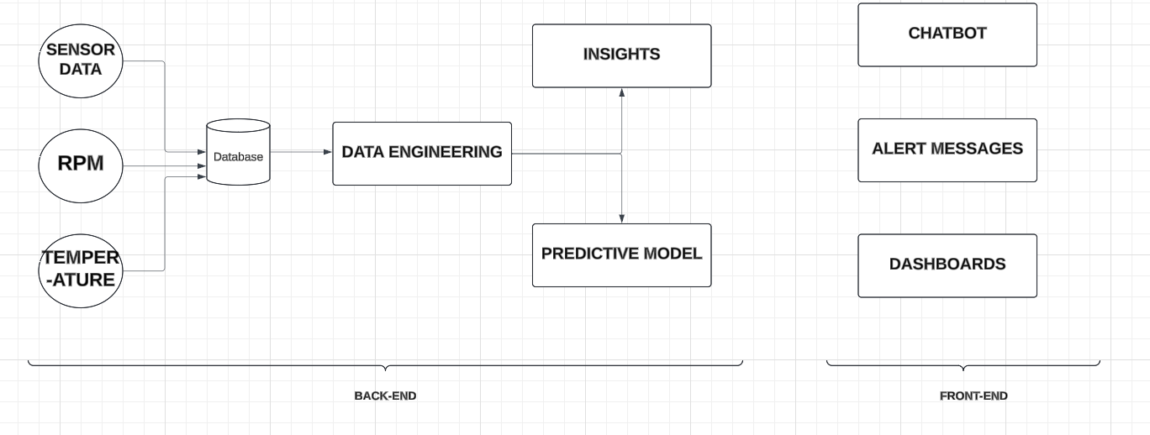
BASIC ARCHITECTURE

Slide 7
MODULES
Data Collection and Preprocessing
Data Pipeline Development
Exploratory Data Analysis (EDA)
Predictive Model Development
UI Chatbot Development
Integration and Deployment

Slide 8
Data Collection and Preprocessing
Data Pipeline Development
Data Acquisition: Continuously gather data from these sensors, ensuring high-frequency sampling to capture detailed machine behavior.
Data Cleaning: Remove noise and handle missing values to ensure the data’s accuracy and reliability. Standardize formats and scales for consistent analysis.Data Pipeline Development
Data Labeling: Identify and label instances of machine failures and normal operations to provide a basis for training predictive models.
Data Ingestion: Set up processes for ingesting data from various sensors into a central database or data warehouse.
Data Storage: Implement efficient storage solutions that can handle the large volume of incoming sensor data and allow for quick retrieval.
Data Processing: Create ETL (Extract, Transform, Load) pipelines to process raw data into a format suitable for analysis.
Real-time Processing: Develop mechanisms for processing data in real-time to enable immediate predictions and alerts.

Slide 9
Exploratory Data Analysis (EDA)
Data Visualization: Use graphical representations to understand the distribution, trends, and correlations within the data.
Feature Engineering: Identify key features that influence machine performance and failure, creating new features as necessary to enhance model performance.
Statistical Analysis: Apply statistical methods to identify patterns, outliers, and anomalies that could indicate potential failures.
Hypothesis Testing: Formulate and test hypotheses about the relationships between different sensor measurements and machine failures.

Slide 10
Machine Learning Models
Support Vector Machines (SVM)
It is a well-suited for the project due to their capability to effectively handle high-dimensional feature spaces typical in sensor data from milling machines. They are robust in separating classes with a clear margin, making them ideal for predicting machine failures in complex datasets.
Gradient Boosting
It has ability to capture complex, non-linear interactions between various sensor data features. This model's iterative approach of building on previous models' errors enables high predictive accuracy, which is essential for reliable predictive maintenance in milling machines.
Gradient Boosting
Has got the greater the
Accuracy, Therefore it is
Used in further
Development of the
Project!!!

Slide 11
UI Chatbot Development
UI Chatbot Development
Chatbot Design: Design a user-friendly interface for the chatbot that facilitates easy interaction and provides intuitive navigation.
NLP Integration: Integrate Natural Language Processing (NLP) capabilities to enable the chatbot to understand and respond to user queries effectively.
Alert System: Develop a system within the chatbot to notify maintenance personnel of potential issues and suggest corrective actions.
System Integration: Integrate the predictive maintenance and chatbot system with existing manufacturing systems and workflows to ensure seamless operation.
Testing and Validation: Conduct thorough testing to validate the system’s performance and reliability under various scenarios.

Slide 12

Thank you!
Let's build something great together.
Ready to take the next step!!

